Slide 1
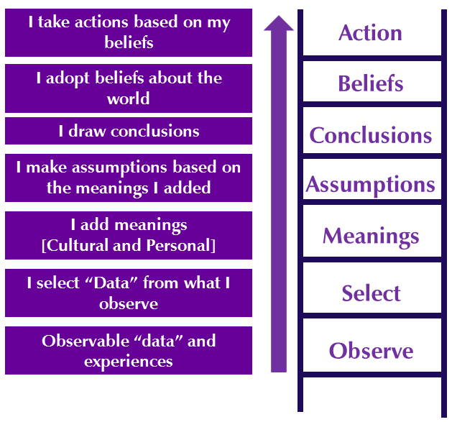
LADDER OF INFERENCE

Slide 2
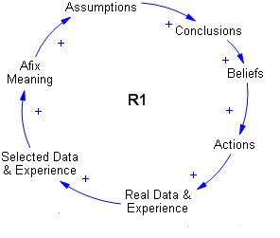
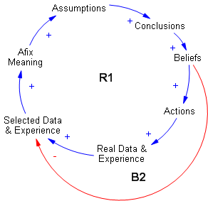

Slide 3
How to stop exclusion and violence
Be aware of your beliefs and look at real data and experience (Ladder inference)
Don’t take the step from stereotype to prejudice
Rely on a good and open social environment
Provide good and openminded education and schooling
Provide free access to independent press
Apply and uphold laws and rules

