Slide 1
Index for inclusion
Lisbon, April 2019
Marleen Clissen

Slide 2
The index for inclusion
What is this instrument?
The goal of this instrument
The focus of this instrument
How to work with the index
Exercises and activities

Slide 3
WHAT IS THE INDEX
The index is an international instrument for school development:
Assessment of the state of play of inclusion in the schoolteams.
A guide for schoolteams in a process of change for innovation with the focus on inclusion, participation and citizenship.

Slide 4
THE GOAL OF THE INDEX
To find for barriers for participation in the environment
To reach a consensus on how to work on awareness raising and work on attitudes:
To find ways of exchanging good practices
To reach a consensus on how to support policies on inclusion

Slide 5
THE FOCUS OF THE INDEX
INCLUSION IN A VERY BROAD SENSE
How does the school deals with diversity?
How does the school work on sustainable education?
How are students prepared for democratic citizenship and respect for full participation of all?

Slide 6
Procedure
You can use the index to reflect with your school-teams.
How are we doing?
What are our strengths?
What is the next feasible step?
The index provides a planning framework for school development

Slide 7
The road to the planning framework
Boothe & Ainscow defined 3 dimensions that deal with topics on inclusion:
Culture
Policy
Practice
Reading: p. 46

Slide 8
The Inclusive triangle: 3 dimensions
B. Producing inclusive policies
C. Evolving inclusive practices
A. Creating inclusive cultures

Slide 9
Planning framework
Each dimension is divided in 2 sections. Sections are the pillars.
Dimensions and sections can form and structure the planning framework (development plan)

Slide 10
Planning framework
Dimension A: creating inclusive cultures:
A1: building communities
A2: establishing inclusive values
Dimension B: producing inclusive policies:
B1: developing the school for all
B2: coordinating support for diversity
Dimension C: evolving inclusive practices:
C1: constructing curricula for all
C2: orchestrating learning

Slide 11
Dimension A: Creating inclusive cultures
= creating a secure, accepting, collaborating welcoming community. Culture is about values and beliefs.
2 sections:
A1: Building Community
A2: Establishing inclusive values

Slide 12
Dimension B: Producing inclusive policies
= ensuring that inclusion is part of all school plans and that everybody is involved: all children and staff from the moment they join the school.
2 sections:
B1: Developing the school for all
B2: Organising support for diversity

Slide 13
Dimension C: Evolving inclusive practices
= developing what and how teaching and learning happens
2 sections:
C1: Orchestrating learning
C2: Mobilizing resources
.

Slide 14
The structure of the Index
Every section had appr. 14 indicators to help you to focus on the areas that you want to change. You can find the indicator by using the questionnaires.

Slide 15
Activity
Take questionnaire 1 (in handouts)
Tick box about your involvement
Take dimension A (creating inclusive cultures)
Take section A1 (building community)
Click your answer in box for question 1 (everyone is welcomed)
Look at indicator A11 (everyone is made to feel welcome) with questions.

Slide 16
The structure of the Index
The connected concrete questions for the school define the meaning of the indicators. The can sharpen the review of the current situation at school.
Questions can be missing: space to add

Slide 17
Result
A state of play of the school
You can decide where to start and progress step by step
Index is not linear
Index is an open approach
Index gives possiblities
Summary reading: p. 13

Slide 18
Activity: linking to current priorities
What actions are schools taking? What pressures are they under?
Find an indicator that might help with a current activity in the school
Look at the questions: do they add something on your current thinking?

Slide 19
Activity: encouraging participation: staff, parents, children, …..
Whose parcticipation do you wish to increase?
Find the indicators/questions that relate to this group
Can you use the questions to support a greater participation of this group?

Slide 20
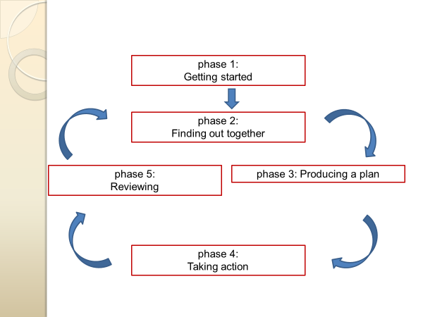
THE PLANNING CYCLE

Slide 21
Strategic planning
Producing a plan:
Reading: p. 175

Slide 22
Exercise for this afternoon
Planning framework: groupwork
Choose priority (one dimension/one indicator)
Connection to other dimensions/indicators?
What are the actual problems? Ideas about barriers to learning and participation?
What can be done? Resources needed to be mobilised? How can we be successful?

Slide 23
SUCCESS WITH THE INDEX!

